Slide 1

Retirement Options
For Machinists in BC.
Cordell Draayers
cdraayers@iamaw.org
604.866.8877

Slide 2
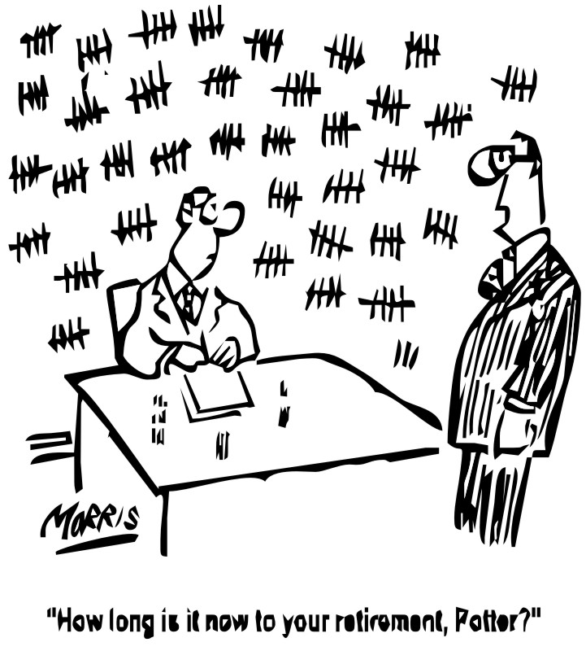

Slide 3
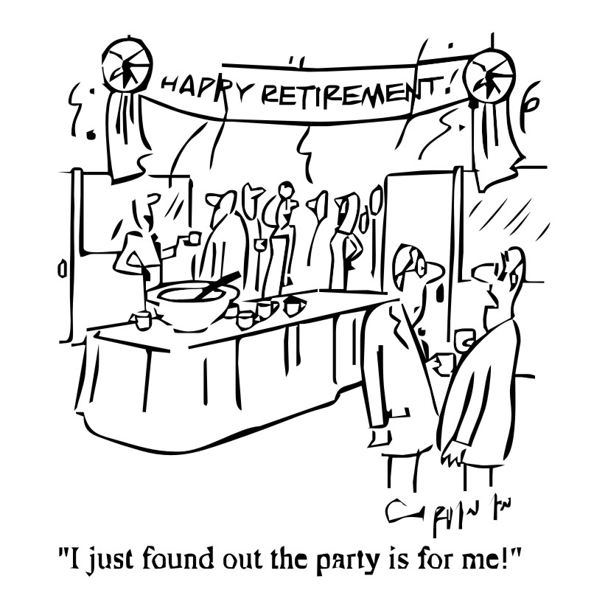

Slide 4

Pension Plans
Pension Plans can be employer, Union or multi-employer.
A Defined Contribution (DC) pension has a set contribution by the employer to an employee account
A Defined Benefit (DB) pension has a set benefit based on years of service
A Hybrid pension has aspects of both DB and DC pensions, some are Target plans.
Employer pensions are dependent on the health of the sponsoring employer. Many bankrupt companies, such as Nortel, have reneged on promised benefits.

Slide 5
Pension Plans (con’t)
A Union pension is dependent on sound investment and sustainable benefit levels.
A multi-employer pension administers for many employers, allowing small companies to offer pensions. The plan is independent of the employers and, like a Union plan, needs prudent management of funds and benefits.
No benefits are cast in stone. A plan may increase benefits if returns on investment are good and reduce benefits if the assets of the plan are hit in a recession.

Slide 6
Pension Plans (con’t)
All registered pension plans are supervised by the Commissioner of Pensions. If a plan assets slip below 100% of what is needed to pay out all obligations, the Commissioner of Pensions will order remedial action either by reducing benefits or increasing contributions.
Likewise, if the funds of a plan grow too great, the plan will be required to reduce contributions or increase benefits. A company plan will always do the former whereas a Union plan often increases benefits.

Slide 7
RRSPs
RRSP savings are the most common form of personal retirement savings.
A maximum of $29,210 per year can be contributed in 2022. Any unused portion of the deduction limit is carried forward to next year.
Money going in is not taxed but withdrawals are. Money goes in when your income is higher and taxed at a higher rate and comes out when your income and tax rate are reduced.

Slide 8
RRSPs (con’t)
RRSPs have two major drawbacks.
  First, the value of your savings is subject to the economy, stock market and interest rates.
  Second, the banks take an average 2 ½% of your RRSP account. That is 2.5% which will be subtracted from any growth in your fund.
A pension typically has a cost of 0.5%,( an extra returns per year over an average RRSP of 2%.

Slide 9
RRSPs (con’t)
If two people saved each $500 a month for 25 years with an average return of 7% less costs of 0.5%, their Pension account could accrue approximately $365,646
But the RRSP, at 7% with higher costs, would come up to $273,865, more than $90,000 less.
As your retirement income is based on the size of your savings account, the actual total paid out over your retirement can be even greater.

Slide 10
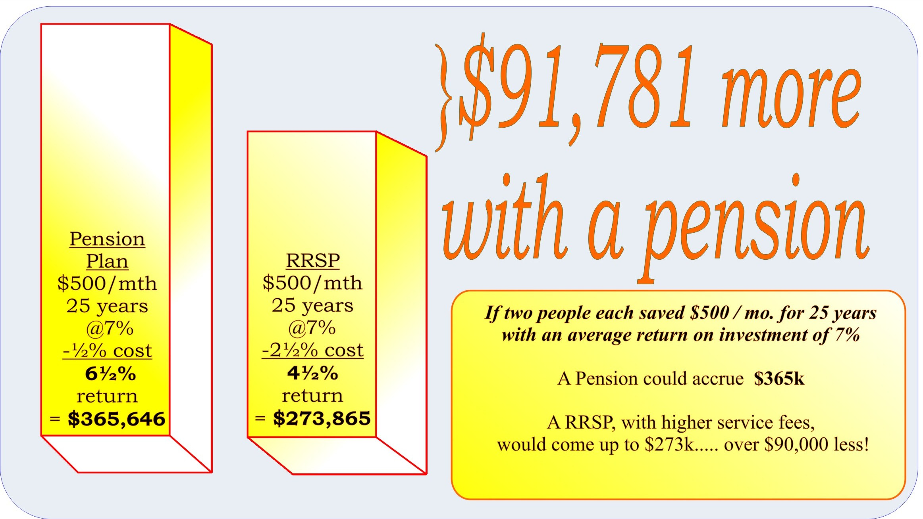
Pension vs. RRSP

Slide 11
TFSA
Tax Free Savings Accounts (TFSA)
  TFSA program allows a maximum investment of $5,500 in 2016. (Indexed to inflation)
  Unlike RRSPs, money going in is taxed; money coming out is not.
  This is an ideal savings plan for low income earners whose income tax rate is low.
  It is also a place to save if the RRSP contributions are maxed out for the year.

Slide 12
RRIF
All RRSPs (but not TFSAs) must be cashed out or converted to Registered Retirement Income Funds (RRIF) by age 71.
Otherwise taxes on entire balance become payable.
The return on a RRIF is dependent on interest rates or investment returns depending on which flavour you choose.
RIFFs are subject to fees and deductions like RRSPs. You are required to withdraw a minimum each month but may draw more, up to a set maximum limit. All withdrawals are subject to taxation.
Retirees can outlive their RRIF money and be reduced to poverty.

Slide 13
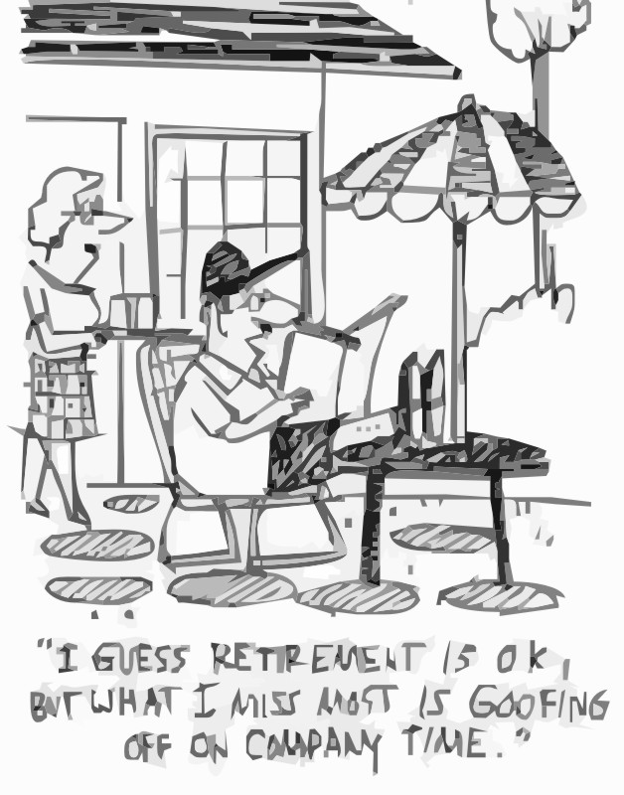

Slide 14
Membership Option
Lodge 692 Machinists Pension Plan
Each member has a dollar account in their name which is used to calculate his / her pension at retirement.
For members of the 692 Pension Plan, upon retirement, a monthly pension is paid, avoiding the need for a fee-based Register Retirement Income Fund (RRIF).
Your money will be paid as long as you or your spouse is alive. There is no danger you will run out of savings during your retirement; a calamity which does happen to those who must convert their RRSP money into a RRIF at retirement.

Slide 15
Lodge 692 Machinists Pension Plan (con’t)
The Plan uses a professional money managers, Leith Wheeler, Concert Properties and IFM. We have enjoyed average annual returns of 8.55% over the last 31 years.
The assets of the plan have grown since 1988 from about $10,000,000 to over $268,441.00 today.
The plan is on sound financial footing and can continue to serve Machinists as long as the need is there.
The 692 Machinists Pension Plan was created in British Columbia by and for members of Local Lodge 692.
In 2011, the Plan was opened up
to all District Lodge 250 Machinists
in Local Lodges 11, 456, 692, 1857 and 2711.

Slide 16
Machinists Pension Plan (LL692) Returns
1988 | 10.00% | 1998 | 6.50% | 2008 | -16.00% | 2018 | -0.20%
1989 | 11.50% | 1999 | 3.50% | 2009 | 16.00% | 2019 | 13.77%
1990 | -2.90% | 2000 | 10.25% | 2010 | 10.75% | 2020 | 6.25%
1991 | 19.50% | 2001 | 4.50% | 2011 | 0.75% | 2021 | 8.40%
1992 | 8.50% | 2002 | 2.00% | 2012 | 9.45% | 2022 | -2.2%
1993 | 25.00% | 2003 | 13.75% | 2013 | 16.70% | 2023
1994 | 0.00% | 2004 | 12.75% | 2014 | 9.60% | 2024
1995 | 13.20% | 2005 | 10.25% | 2015 | 1.53% | 2025
1996 | 15.75% | 2006 | 14.25% | 2016 | 11.00% | 2026
1997 | 17.00% | 2007 | 0.50% | 2017 | 12.1 | 2027
Average Yearly Return For 33 Years: Over 8.39%

Slide 17
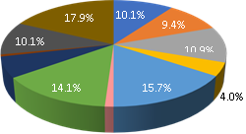
Machinists Pension Plan
The 692 Plan is a balance fund
0.6%
6.3%
1.0%

Slide 18
Asset Allocation By Managers
As of June 2019

Slide 19
692 Pension Payment Options
How do I get access to my money?
Prior to retirement, contact the Pension Administrator, who will walk you through your various options
What about before I retire?
  You cannot access your Pension Account unless you retire or cease to be a Member of the Pension Plan except for voluntary contributions.
  Voluntary contributions are always accessible, even if still a Member. There is no cost for the first early withdrawal but subsequent early withdrawals are subject to a fee of $75 + tax

Slide 20
692 Pension Payment Options (con’t)
To access Collective Agreement mandated Employer and Employee you must either:
  Retire
  -or-
  Cease to be an active Member of the Pension Plan because you no longer are employed under a Collective Agreement which includes the 692 Pension Plan.
  You will remain an inactive Member of the Plan until retirement unless you choose to leave.

Slide 21
692 Pension Payment Options (con’t)
If your age is less than 55 years old and you are no longer an active Member of the Pension Plan, you may close (cash out) your Pension Account and will receive the larger of:
  your Pension Account
  -or-
  the commuted value of your Pension Account

Slide 22
692 Pension Payment Options (con’t)
At 55, you must take a monthly Pension, unless the account balance is less than $11,180.00 not including voluntary contributions (20% YMPE 55,900.00) 2018 . If so, you may close the Pension Account and take the lump sum.

Slide 23
692 Pension Payment Options (con’t)
The amount of Pension you receive per month is calculated from:
  The total in your Savings Account
  The age of you and your spouse
  The survivor benefit chosen by a married Member
  The guaranteed payment option selected
  The current interest rate of the Pension Plan

Slide 24
692 Pension Payment Options (con’t)
The Normal Form Monthly Pension for Retirees 65 years old:
  Married with the default 60% Survivor Pension
  Single with a 5 year of guaranteed payments
For every month before your 65th birthday, the Pension is reduced by ½% less or 6% per year.
Retiring on your 63rd birthday will reduce your monthly payment by 24 months X 0.5% = 12%.
The reduction is made as an early Pension will be paid for longer compared to a standard retirement at 65 years old.
There is no reduction of the member’s account balance.
There are no deferred pensions.

Slide 25
692 Pension Payment Options (con’t)
Unless the Spouse signs a Release Waiver, Canadian Pension Law dictates a surviving Spouse will receive a 60% pension.
  A pension will be higher with no Survivor benefit.
  If you opt for a 100% Survivor Pension, the monthly amount will be reduced. Other options include 50% or 75% Survivor Pensions.

Slide 26
692 Pension Payment Options (con’t)
Single Pensioners can opt for a guarantee of 60, 120 or 180 months or waive the guarantee entirely. Monthly payments will be adjusted accordingly. Should the Pensioner die before the end of the guarantee, his estate will receive the remaining payments.
Married Pensioners can choose to include a guarantee. If the Pensioner dies during the guarantee period, his survivor will receive full payment to the end of the guarantee and then receive the survivor benefit.

Slide 27
692 Pension Payment Options (con’t)
These are examples of how Survivor Benefits affect monthly payments
for a Single Pensioner:
Option | Monthly Pension | % of Default Pension
0 months guarantee | $2,922 | 101%
60 months guarantee | $2,882 (Default Pension) | 100%
120 months guarantee | $2,776 | 96%
180 months guarantee | $2,632 | 91%
These are for illustration only. When you retire, the Pension Administrator will present your personal options for monthly payments.

Slide 28
692 Pension Payment Options (con’t)
These are examples of how
Survivor Benefits affect monthly payments
for a Married Pensioner:
Option | Monthly Pension | % of Default Pension
No survivor benefit | $2,922 | 117%
50% survivor benefit | $2,562 | 102%
60% survivor benefit | $2,501 (Default Pension) | 100%
75% survivor benefit | $2,414 | 96%
100% survivor benefit | $2,281 | 91%
These are for illustration only. When you retire, the Pension Administrator will present your personal options for monthly payments.

Slide 29
692 Pension Plan (con’t)
Voluntary contributions are allowed for any active Member either:
  As a Registered Plan to Pension Plan transfer
    RRSP ➔ 692 Pension Plan
    Other Registered Pension Plan ➔ 692 Pension Plan
  (These transfers attract no tax)
  Additional lump or monthly contributions through payroll
  (These contributions will not be taxed
  up to your contribution limit)

Slide 30
What Annuities Are Paying
CANNEX Financial Exchanges Limited
Annuities: Single life male, 10 year guarantee
Financial Institution | Age in Years
 | 55 | 60 | 65 | 69 | 70 | 75 | 80
BMO insurance | 423.78 | 468.67 | 529.48 | 590.50 | 607.68 | 697.58 | 781.78
Canada Life | 419.84 | 484.39 | 527.15 | 574.77 | 600.00 | 674.35 | 757.07
Desjardins Fin. Security | 420.25 | 467.01 | 526.60 | 583.55 | 598.95 | 666.12 | 748.31
Empire Life | 437.29 | 476.78 | 525.15 | 570.81 | 583.51 | 657.05 | 756.29
Equitable Life | 439.14 | 480.49 | 515.78 | 552.75 | 563.54 | 631.00 | 682.62
Great-West Life | 419.84 | 484.39 | 527.15 | 574.77 | 600.00 | 674.35 | 757.07
London Life | 419.84 | 484.39 | 527.15 | 574.77 | 600.00 | 674.35 | 757.07
Manulife Investments | 407.46 | 437.58 | 479.43 | 525.75 | 541.24 | 615.34 | 707.88
RBC Life Insurance | 409.58 | 453.40 | 516.98 | 573.54 | 588.36 | 673.98 | 762.02
Standard Life | 413.27 | 454.83 | 508.46 | 560.36 | 574.48 | 634.74 | 710.42
Sun Life Assurance Co | 413.53 | 466.11 | 541.13 | 600.22 | 617.11 | 688.19 | 766.82

Slide 31
Members Contributions
Money is Deposited
Deposit Information
Canadian Western Trust
Administrator
D A
Townley
Payment Verification
Pension & Payout
Requests
Pension Cheques
Investment Instruction
Instruction and Compliance
Member
Collecting
Pension
Investor
Lieth Wheeler
Pension Trustees
Plan Returns
and investment
Recommendations

Slide 32
The Hidden Advantage of a Register Pension Plan
If your employer goes bankrupt,
any contributions mandated by the Collective Agreement to a Registered Pension Plan have Super-Priority in receivership.
The Receiver must make good on Pension contributions before anyone else is paid
  …even the Banks!

Slide 33

Happy Dreams!

Slide 34
How Target Plans Help

